Slide 1



CME Commodities Trading Data Warehouse
A comprehensive cloud-based solution for analyzing commodities market trends and trading patterns
By Samin Yasar, Ruben Rodriguez, Linda Li

Slide 2
What is CME?
Chicago Mercantile Exchange (CME) is one of the world’s largest financial derivatives exchanges.
🔹 Facilitates trading of futures & options on: • Commodities (corn, soybeans, crude oil) • Stock indexes, interest rates, FX, crypto
🔹 Enables price discovery and risk management for global markets
🔹 Serves as a central marketplace for buyers and sellers to trade based on future price expectations

Slide 3





Project Goal and Importance
Developed an end-to-end cloud-based data warehouse for analyzing CME commodities trading data and uncovering the most frequently traded assets
Provides critical insights into market activity and trading patterns
Supports data-driven decision-making for stakeholders
Enables identification of high-volume trading opportunities
Facilitates comprehensive analysis of commodity market trends
CIS4400 Data Warehouse Summer 2025

Slide 4




Requirements Details
Track most traded securities and assets by exchange for commodities
Aggregate revenue data by commodities and asset types
Drill down analysis by week/time periods
Real-time data integration capabilities
CIS4400 Data Warehouse Summer 2025

Slide 5



Business Personas
IT Manager
Project Manager
Oversees technical implementation and infrastructure
Coordinates team tasks, timelines, and stakeholder communication
Data Analyst
Data Engineer
Responsible for data analysis, reporting, and insights generation
Builds and maintains data pipelines and infrastructure
CIS4400 Data Warehouse Summer 2025

Slide 6
Benefits and Costs
Enhanced insights into market activity
$
Support for data-driven decision-making
Key Benefits
Clear understanding of trade volume patterns
Cost: $0
All tools and platform is provided by Baruch College
Improved analytical capabilities
Scalable architecture for future growth
CIS4400 Data Warehouse Summer 2025

Slide 7
Solution to the Requirements
Our Approach
We implemented a comprehensive data warehouse solution utilizing modern cloud technologies and industry best practices, adhering to both dimensional modeling and star schema architecture principles.
Architecture Overview
CME Data → ETL/ELT Processing → Data Warehouse → Analytics & Visualization
Medallion Layers:
Medallion Layers: Bronze (Raw) → Silver (Cleaned) → Gold (Aggregated)
CIS4400 Data Warehouse Summer 2025

Slide 8
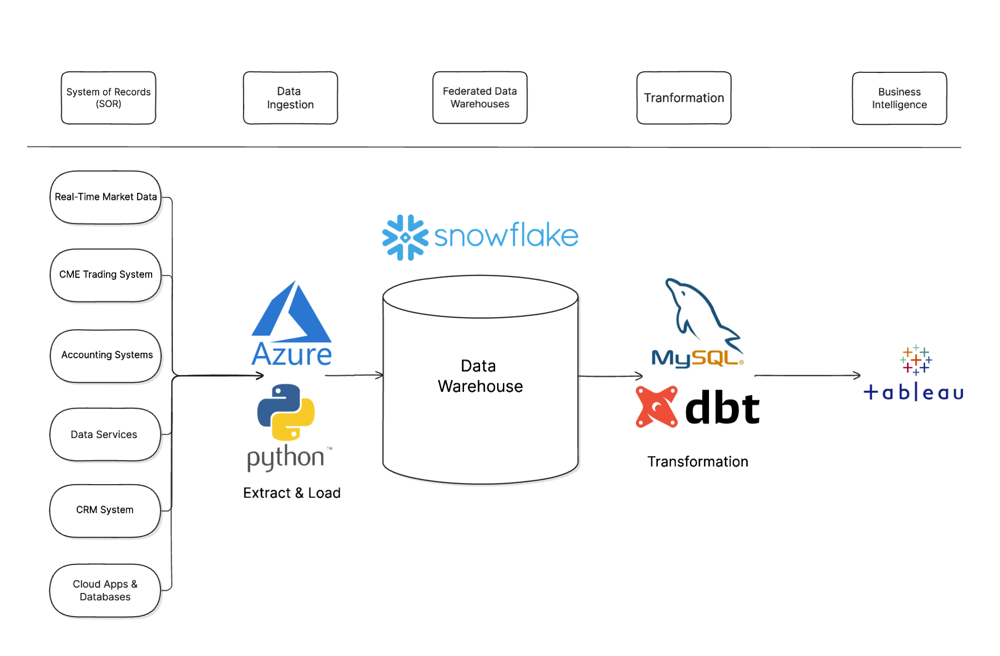

Slide 9

Question Recap
What is the most traded securities and assets by exchange for the commodities?
Which assets generate the most revenue drilled down by week.
CIS4400 Data Warehouse Summer 2025

Slide 10
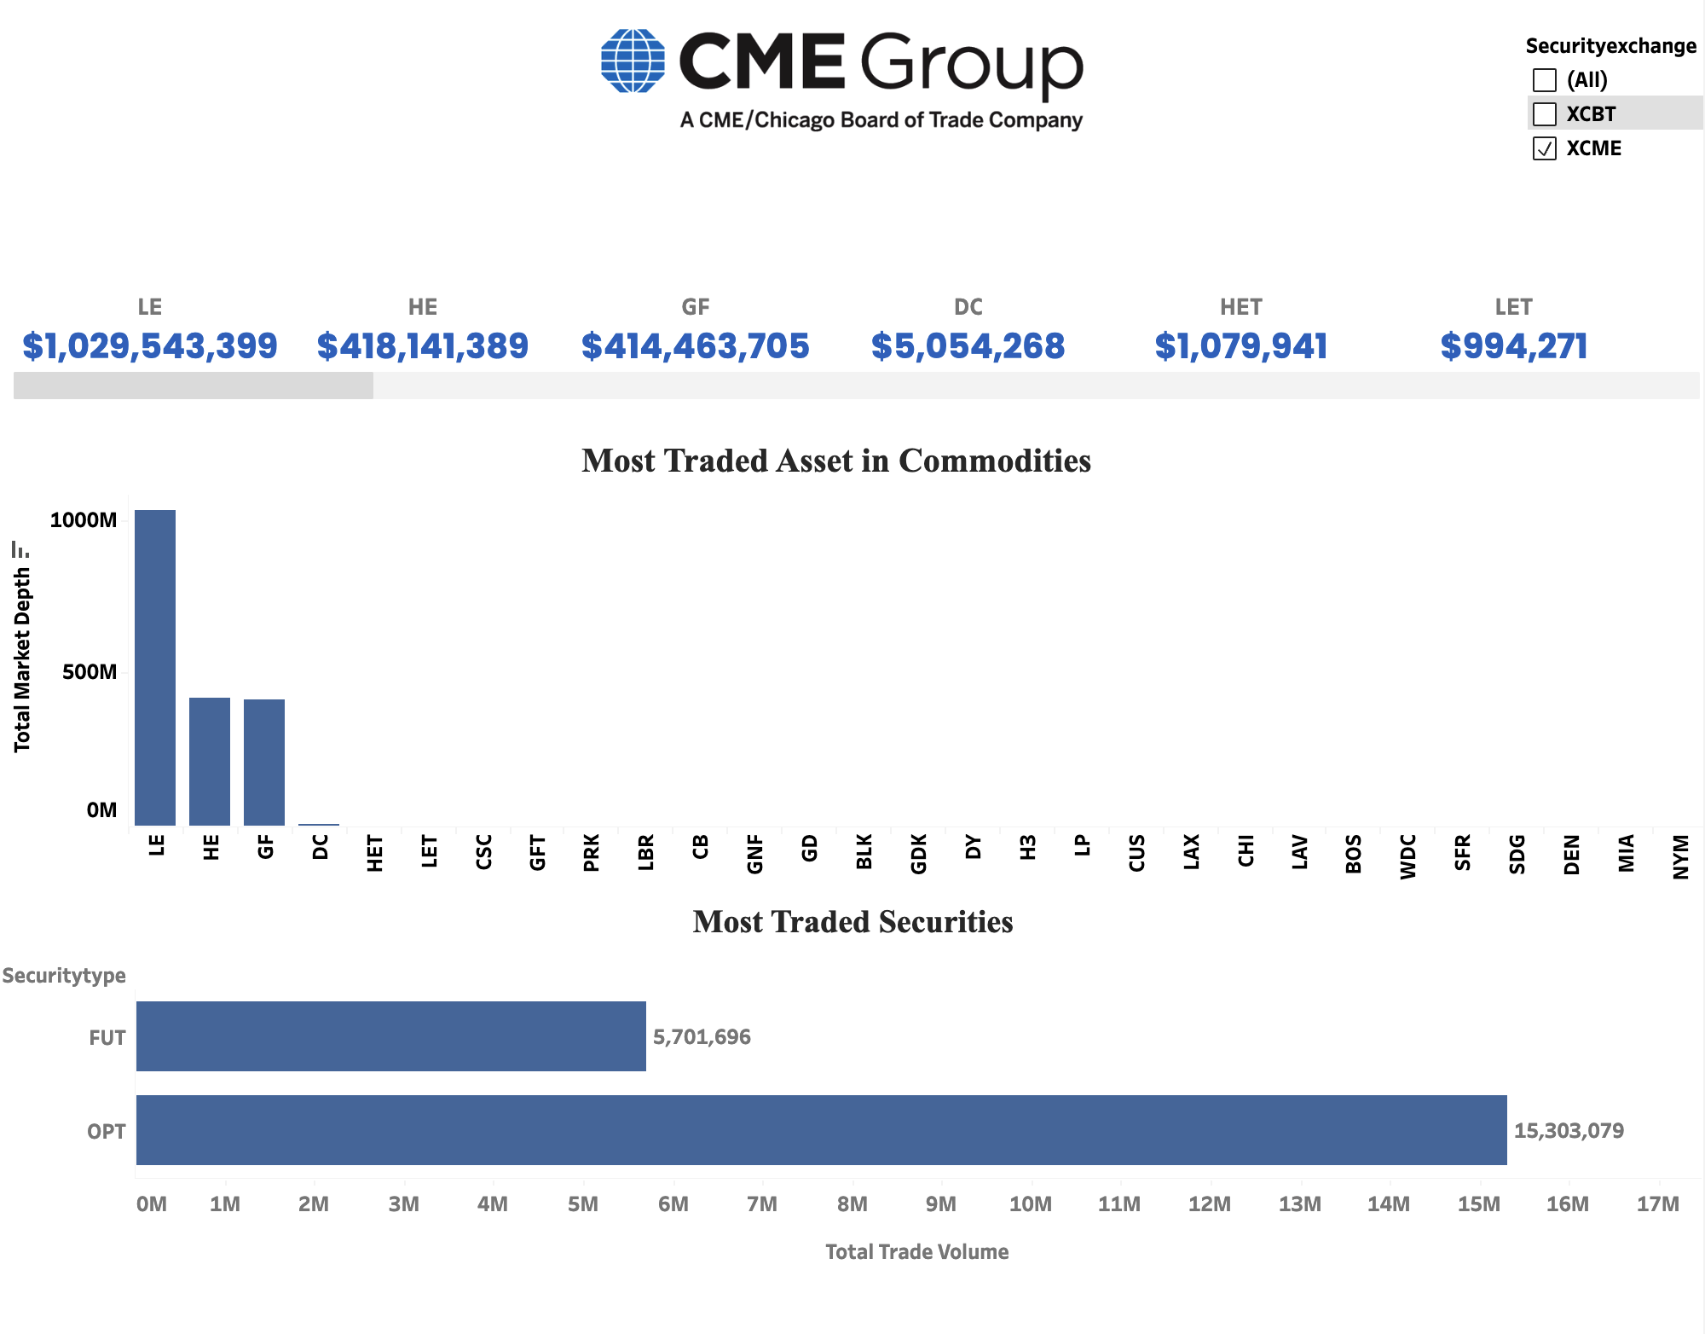
CIS4400 Data Warehouse Summer 2025

Slide 11
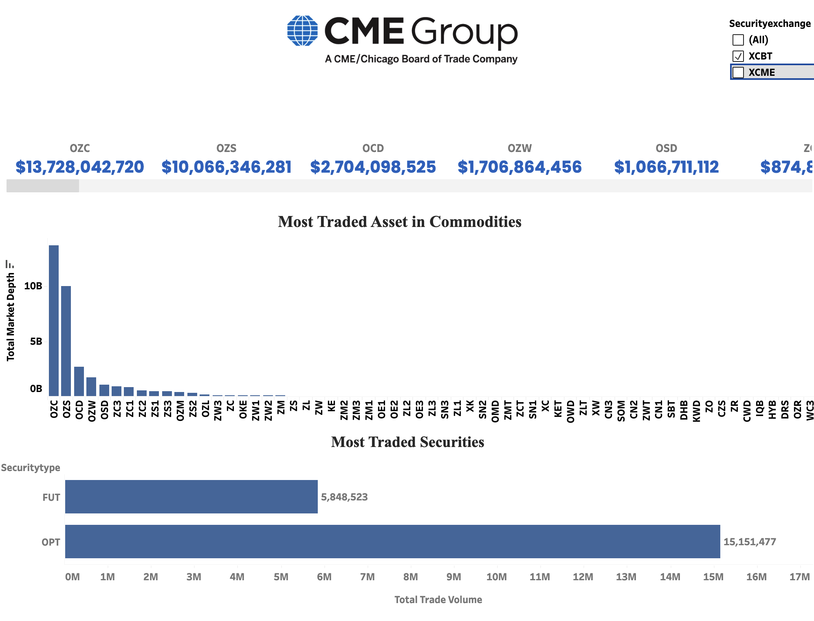

Slide 12
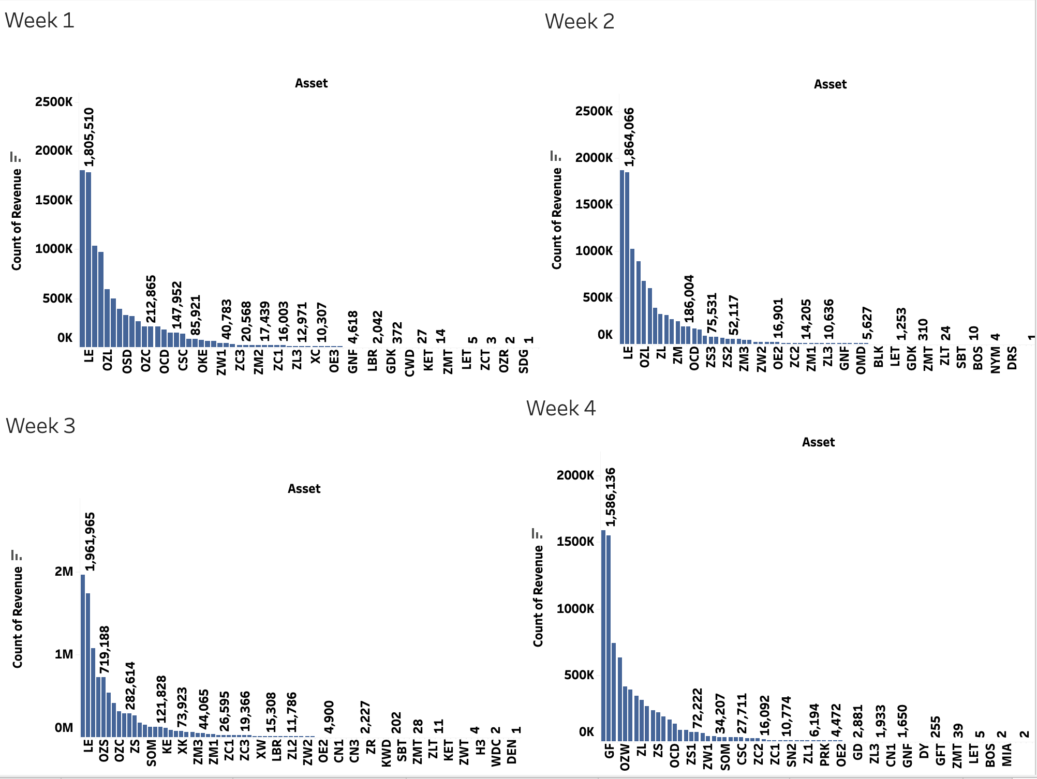

Slide 13
Commodities Trading Data insight
Market Volume
Market Volume
The CME exchange was dominated by the LE, HE, and GF futures in December 2024.
The CBT exchange appears heavily concentrated in just 2 assets (0ZC and 0ZS) which together account for over 80% of the top 5's trading volume
Live Cattle Futures (LE) dominated the exchanges with more than $1,800,000 in Week 1, constantly increasing to $1,961,965 by Week 3.
On the last week, it was overtaken by Feeder Cattle Futures (GF) at $1,586,136.
CIS4400 Data Warehouse Summer 2025

Slide 14
What does this mean?
CIS4400 Data Warehouse Summer 2025

Slide 15
Summary of the results
Successfully implemented star schema for commodities trading data
Established automated ETL pipelines for real-time data processing
Created comprehensive dashboards for market analysis
Identified top-performing commodities by trading volume
CIS4400 Data Warehouse Summer 2025

Slide 16
👥 Team Contributions
️Samin
🧱 Architecture Design
🗂️ Schema Implementation
🔄 ETL Pipeline Development
Linda
🗒️ Documentation & Presentation PPT
📝 Requirements Gathering
Ruben
📈 Data Analysis & Modeling
🖼️ Visualization Development
✅ Testing & Validation
Collaborative Efforts
🔧System Integration
🛠️ Troubleshooting
📅 Deliverables & Deadlines Management
CIS4400 Data Warehouse Summer 2025

Slide 17
Conclusion
🏆 What We Achieved
🚀 Moving Forward
📦 Scalable Data Warehouse - designed for CME trading data
📊 Advanced Analytics — providing deep insights into commodity markets
⚡ Real-time pipelines — enabling automated data processing
🔍 Actionable Reports – empowering stakeholders with data-driven decision-making
🌐 Expand Exchanges
🤖 AI & Machine Learning
📈 More Enhanced Analytics
CIS4400 Data Warehouse Summer 2025

Slide 18
Future Work
Technical enhancement
Business Extensions
Scalability improvement
Real-time streaming data
ML- powered predictive analytics​​
Advanced data quality monitoring​​
Automated anomaly detection​​
Integration with other exchanges(CBOT,NYMEX)​​
Risk management analytics​​
Portfolio optimization tools​​
Regulatory compliance reporting​
Containerization(Docker/Kubernetes)
Monitoring & alerting systems
Multi-region deployments(Global trading operations)

Slide 19


Thank You!
For questions or further information regarding CME Commodities Data Warehouse Project, please contact any team member through the university email system.
CIS4400 Data Warehouse Summer 2025

